Slide 1
Glaucoma Diagnosis using Deep Learning
Manas Hostel

Slide 2
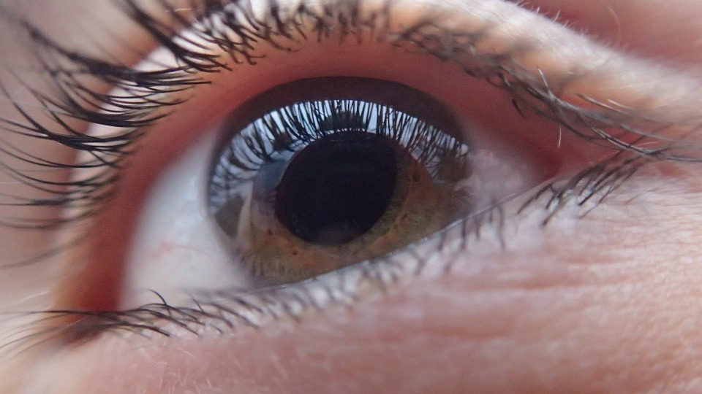
The problem: Glaucoma
Glaucoma is an eye disease that is known to cause damage to the optic nerve and result in permanent loss of vision.
Glaucoma is the second leading cause of blindness in the world accounting for upto 8% of total blindness.

Slide 3

The burden of the Disease in India
A survey in 2010 estimated that over 10 million people in India were affected by Glaucoma
Most of these cases are undetected and there exist major challenges in detecting and treating these diseases.

Slide 4
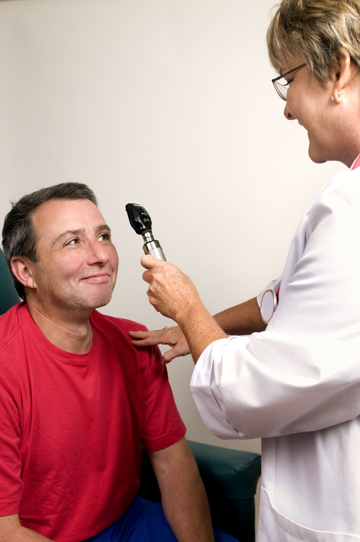
Diagnosis
Most of those with disease are undetected and there exist major challenges in detecting and treating those with disease.
Tests which are used in the diagnosis of glaucoma include – measurement of pressure of the eye using an instrument called tonometer, a look at the optic nerve head with an ophthalmoscope etc.
Its usually difficult to detect the disease in the early stages.

Slide 5
Early Diagnosis is Important
Lots of cases of misdiagnosis. Hence the disease goes undetected.
If not detected early enough, the treatment can be expensive and the damage, devastating.

Slide 6
The goal
To use deep learning to diagnose whether a person has Glaucoma or not.
The input will be a retinal image of the eye of the patient. These are easy to take.
A well trained model can therefore be extremely effective, definitely more so than a human, in detecting early signs of glaucoma.
This thus would mean that glaucoma can be diagnosed early.

Slide 7
The Dataset
It contains about 400 retinal images. This is a relatively small dataset but it required no cleaning. Also we used data augmentation to to significantly increase the diversity of data available for the training model.
The dataset is reasonable to use in the context of India as Glaucoma is a problem around the world and living in different Geographical areas shouldn’t gravely affect the causes of glaucoma.

Slide 8
The Model
We used a convolutional neural network with five layers to solve the problem.
We arrived at this by trial and this gave us an accuracy of about 75%.
We used the categorical cross entropy loss function which is usually the loss function used in the case of single label classification problems.
Since we had a relatively small dataset we used data augmentation to diversify our data.

Slide 9
The Model
The hyperparameters used are: batch size, number of epochs, steps per epoch.
The learning rate was adjusted to prevent overfitting

Slide 10
Thank You

